Slide 1
Cross-Cultural Negotiation

Slide 2
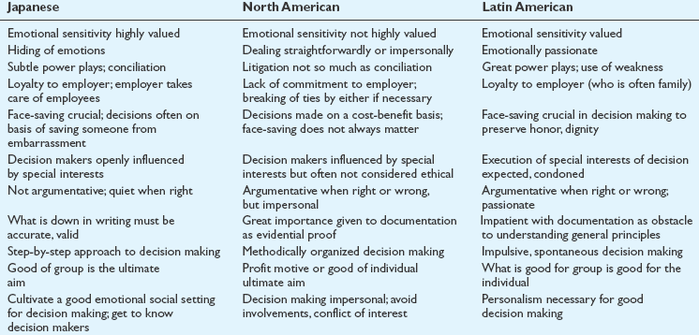
Understanding Negotiation Styles
Notes:
Global managers can benefit from studying differences in negotiating behaviors (and the
underlying reasons for them), which can help them recognize what is happening in the
negotiating process.

Slide 3
Flexibility Cooperation: Intercompany Interaction and Negotiation
Negotiation Styles from a Cross-Cultural Perspective
Adapted from Table 7–7: Negotiation Styles from a Cross-Cultural Perspective

Slide 4
Flexibility Cooperation: Intercompany Interaction and Negotiation
Negotiation Styles from a Cross-Cultural Perspective
Adapted from Table 7–7: Negotiation Styles from a Cross-Cultural Perspective

Slide 5
Effective Negotiation Characteristics
Adapted from Table 7-10: Culture-Specific Characteristics Needed by International Managers for Effective Negotiations

Slide 6
Effective Negotiation Characteristics
Adapted from Table 7-10: Culture-Specific Characteristics Needed by International Managers for Effective Negotiations

Slide 7
Understanding Negotiation Styles
For North Americans, negotiations are businesslike; their factual appeals are based on what they believe is objective information, presented with the assumption that it is understood by the other side on a logical basis.
Arabs use affective appeals based on emotions and subjective feelings.
Russians employ axiomatic appeals – that is, their appeals are based on the ideals generally accepted in their society.

Slide 8
Profile of an American Negotiator
Knows when to compromise
Takes a firm stand at the beginning of the negotiation
Refuses to make concessions beforehand
Keeps his or her cards close to his or her chest
Accepts compromises only when the negotiation is deadlocked
Sets up the general principles and delegates the detail work to associates
Keeps a maximum of options open before negotiation
Operates in good faith

Slide 9
Profile of an American Negotiator
Respects the “opponents”
States his or her position as clearly as possible
Knows when he or she wishes a negotiation to move on
Is fully briefed about the negotiated issues
Has a good sense of timing and is consistent
Makes the other party reveal his or her position while keeping his or her own position hidden as long as possible
Lets the other negotiator come forward first and looks for the best deal

Slide 10
Profile of an Indian Negotiator
Looks for and says the truth
Is not afraid of speaking up and has no fears
Exercises self-control
Seeks solutions that will please all the parties involved
Respects the other party
Neither uses violence nor insults
Is ready to change his or her mind and differ with himself or herself at the risk of being seen as inconsistent and unpredictable

Slide 11
Profile of an Indian Negotiator
Puts things into perspective and switches easily from the small picture to the big one
Is humble and trusts the opponent
Is able to withdraw, use silence, and learn from within
Relies on himself or herself, his or her own resources and strengths
Appeals to the other party’s spiritual identity
Is tenacious, patient, and persistent
Learns from the opponent and avoids the use of secrets
Goes beyond logical reasoning and trusts his or her instinct as well as faith

Slide 12
Profile of an Arab Negotiator
Protects all the parties’ honor, self-respect, and dignity
Avoids direct confrontation between opponents
Is respected and trusted by all
Does not put the parties involved in a situation where they have to show weakness or admit defeat
Has the necessary prestige to be listened to
Is creative enough to come up with honorable solutions for all parties
Is impartial and can understand the positions of the various parties without leaning toward one or the other

Slide 13
Profile of an Arab Negotiator
Is able to resist any kind of pressure that the opponents could try to exercise on him
Uses references to people who are highly respected by the opponents to persuade them to change their minds on some issues
Can keep secrets and in so doing gains the confidence of the negotiating parties
Controls his temper and emotions
Can use conference as mediating devices
Knows that the opponent will have problems in carrying out the decisions made during the negotiation
Is able to cope with the Arab disregard for time

Slide 14
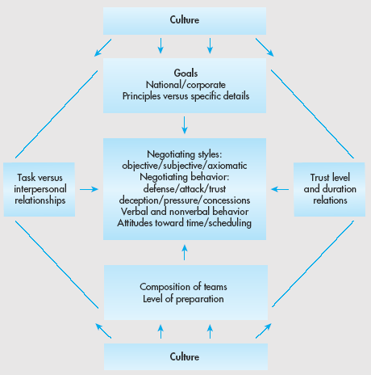
Managing Negotiation
Notes:
This slide illustrates the relationships among the factors of cross-cultural negotiation.

Slide 15
Managing Negotiation
Successful management of intercultural negotiations requires the manager
To gain specific knowledge of the parties in the upcoming meeting
To prepare accordingly to adjust to and control the situation
To be innovative
Notes:
Skillful global managers must assess many factors when managing negotiations. They must understand the position of the other parties in regard to their goals—whether national or corporate—and whether these goals are represented by principles or specific details. They should have the ability to recognize the relative importance attached to completing the task versus developing interpersonal relationships. Managers also must know the composition of the teams involved, the power allotted to the members, and the extent of the teams’ preparation. In addition, they must grasp the significance of personal trust in the relationship.

Slide 16
Comparative Management in Focus: Negotiating with the Chinese
The Chinese think in terms of process that has no culmination. Americans think in terms of concrete solutions to specific problems. . . . The Chinese approach is impersonal, patient and aloof . . .To Americans, Chinese leaders seem polite but aloof and condescending. To the Chinese, Americans appear erratic and somewhat frivolous.
—Henry Kissinger,
Newsweek, May, 2001

Slide 17
Comparative Management in Focus: Negotiating with the Chinese
Business people have two major areas of conflict when negotiating with the Chinese
Amount of detail about product characteristics
Apparent insincerity about reaching an agreement
Chinese negotiation process is affected by three cultural norms
Politeness and emotional restraint
Emphasis on social obligations
Belief in the interconnection of work, family, and friendship

Slide 18
Comparative Management in Focus: Negotiating with the Chinese
Tips to foreigners conducting business in China
Practice patience
Accept prolonged periods of stalemate
Refrain from exaggerated expectations
Discount Chinese rhetoric about future prospects
Expect the Chinese to try to manipulate by shaming
Resist the temptation to believe that difficulties are your fault
Try to understand Chinese cultural traits
Notes:
The Chinese are among the toughest negotiators in the world. American managers must anticipate various tactics, such as their delaying techniques and their avoidance of direct, specific answers: Both ploys are used to exploit the known impatience of Americans. The Chinese frequently try to put pressure on Americans by “shaming” them, thereby implying that the Americans are trying to renege on the friendship—the basis of the implicit contract. Whereas Westerners come to negotiations with specific and segmented goals and find it easy to compromise, the Chinese are reluctant to negotiate details. They find it difficult to compromise and trade because they have entered negotiations with a broader vision of achieving development goals for China, and they are offended when Westerners don’t internalize those goals.

Slide 19
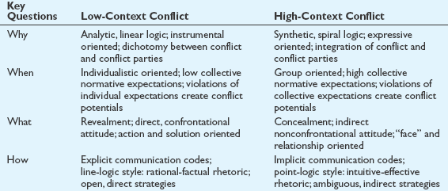
Managing Conflict
Notes:
Much of the negotiation process is fraught with conflict—explicit or implicit—and such conflict can often lead to a standoff, or a lose–lose situation. This is regrettable, not only because of the situation at hand, but also because it probably will shut off future opportunities for deals between the parties. Much of the cause of such conflict can be found in cultural differences between the parties—in their expectations, in their behaviors, and particularly in their communication styles.

Slide 20
Cultural Variables Affecting Decision Making
Objective (basing decisions on rationality) versus subjective (basing decisions on emotions) approach
Risk tolerance
Locus of control – internal (managers in control of events), or external (managers have little control over events)

Slide 21
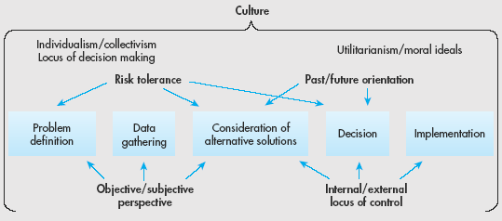
Cultural Variables Affecting Decision Making

Slide 22
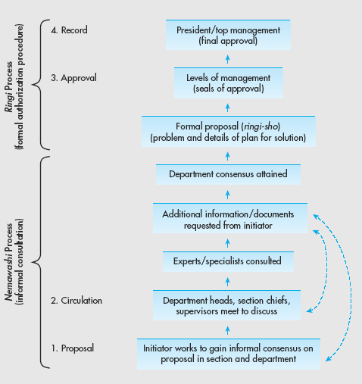
Comparative Management in Focus: Decision Making in Japan
Notes:
Having an understanding of the Japanese decision making process is vital for any manager that will be working within this country. This understanding will come from having an understanding that the Japan’s national culture is one that is based on relationships, and team work. It is this culture of collectivism and shared responsibility that underlies the Japanese ringi system of decision making. In the ringi system, the process works from the bottom up. Americans are used to a centralized system, where major decisions are made by upper-level managers in a top-down approach typical of individualistic societies. The Japanese process, however, is dispersed throughout the organization, relying on group consensus. The ringi system is cumbersome and very time-consuming prior to the implementation stage, although implementation is facilitated because of the widespread awareness of and support for the proposal already gained throughout the organization. However, its slow progress is problematic when decisions are time-sensitive. This process is the opposite of the Americans’ top-down decisions, which are made quite rapidly and without consultation, but which then take some time to implement because unforeseen practical or support problems often arise.

Slide 23
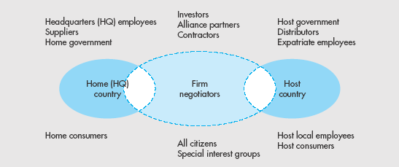
Stakeholders
Return
Notes:
This slide illustrates the different stakeholders involved in global negotiations.

Slide 24
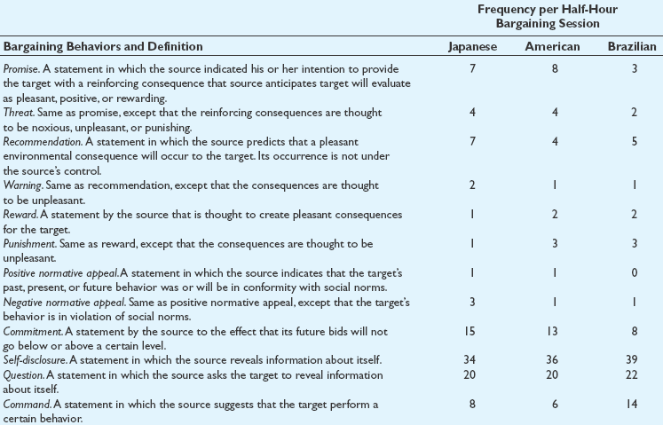
Persuasion Tactics
Return

Slide 25
Explicit and Implicit Communication
High-context/implicit communication cultures
Japanese
Arabs
Latin Americans
Italians
English
French
North Americans
Scandinavians
Low-context/explicit communication cultures
Germans
Swiss Germans

Slide 26
Phases of Multicultural Development
Table 7–1
Major Characteristics of Verbal Styles
Cultures in Which Major Interaction Focus Characteristic It Verbal Style Variation and Content Is Found
Indirect vs. direct
Indirect
Direct
Implicit messages
Explicit messages
Collective, high context
Individualistic, low context
Succinct vs. elaborate
Elaborate
High quantity of talk
Moderate uncertainty avoidance, high context
Exacting
Moderate amount of talk
Low uncertainty avoidance, low context
Succinct
Low amount of talk
High uncertainty avoidance, high context

Slide 27
Phases of Multicultural Development
Table 7–1
Major Characteristics of Verbal Styles
Cultures in Which Major Interaction Focus Characteristic It Verbal Style Variation and Content Is Found
Contextual vs. personal
Contextual
Focus is on the speaker and role relationships
High power distance, collective, high context
Personal
Focus is on the speaker and personal relationships
Low power distance, individualistic, low context
Affective vs. instrumental
Affective
Language is process oriented and receiver focused
Collective, high context
Instrumental
Language is goal oriented and sender focused
Individualistic, low context

Slide 28
Summary of Verbal Styles

Slide 29
Communication Epigrams
Adapted from Figure 7–2: Communication Epigrams

Slide 30
Communication Barriers
Language barriers
Cultural barriers
Suggestions that can be of value to American managers who are engaged in international communications include:
Be careful not to use generalized statements about benefits, compensation, pay cycles, holidays, or policies in your worldwide communications.
Since most of the world uses the metric system, be sure to include converted weights and measures in all internal and external communications.
Keep in mind that even in English-speaking countries, words may have different meanings. Not everyone knows what is meant by “counterclockwise,” or “quite good.”

Slide 31
Communication Barriers
Language barriers
Cultural barriers
Suggestions that can be of value to American managers who are engaged in international communications include:
Remember that letterhead and paper sizes differ worldwide. The 81⁄2 by 11-inch page is a U.S. standard, but most countries use an A4 (81⁄4 111⁄2-inch) size for their letterhead, with envelopes to match.
Dollars are not unique to the United States. There are Australian, Bermudian, Canadian, Hong Kong, Taiwanese, and New Zealand dollars, among others. So when referring to American dollars, it is important to use “US$.”

Slide 32
Nonverbal Communication
Nonverbal communication
The transfer of meaning through means such as body language and use of physical space
Kinesics
The study of communication through body movement and facial expression
Eye contact
Posture
Gestures
Chromatics
The use of color to communicate messages

Slide 33
Nonverbal Communication
Proxemics
The study of the way that people use physical space to convey messages
Intimate distance is used for very confidential communications
Personal distance is used for talking with family and close friends
Social distance is used to handle most business transactions
Public distance is used when calling across the room or giving a talk to a group

Slide 34
Personal Space in the U.S.
Intimate distance
18”
Personal distance
18” to 4’
Social distance
4’ to 8’
Public distance
8’ to 10’

Slide 35
Nonverbal Communication
Chronemics
Monochronic time schedule
Things are done in a linear fashion.
Manager addresses Issue A first and then moves on to Issue B
Time schedules are very important and time is viewed as something that can be controlled and should be used wisely
Polychronic time schedules
People tend to do several things at the same time
People place higher value on personal involvement than on getting things done on time
Schedules are subordinated to personal relationships

Slide 36
Achieving Communication Effectiveness
Improve feedback systems
Two basic types of feedback systems between home office and affiliates
Personal (e.g., face-to-face meetings, telephone conversations and personalized e-mail)
Impersonal (e.g., reports, budgets, and plans)
Language training
Cultural training
Flexibility and cooperation

Slide 37
Cultural Differences Affecting Negotiations
Do not identify the counterpart’s home culture too quickly. Common cues (e.g., name, physical appearance, language, accent, location) may be unreliable.
Beware of the Western bias toward “doing.” Ways of being (e.g., comportment, smell), feeling, thinking, and talking can shape relationships more powerfully than doing.
Counteract the tendency to formulate simple, consistent, stable images.
Do not assume that all aspects of the culture are equally significant.
Recognize that norms for interactions involving outsiders may differ from those for interactions between compatriots.
Do not overestimate your familiarity with your counterpart’s culture.

